Slide 1
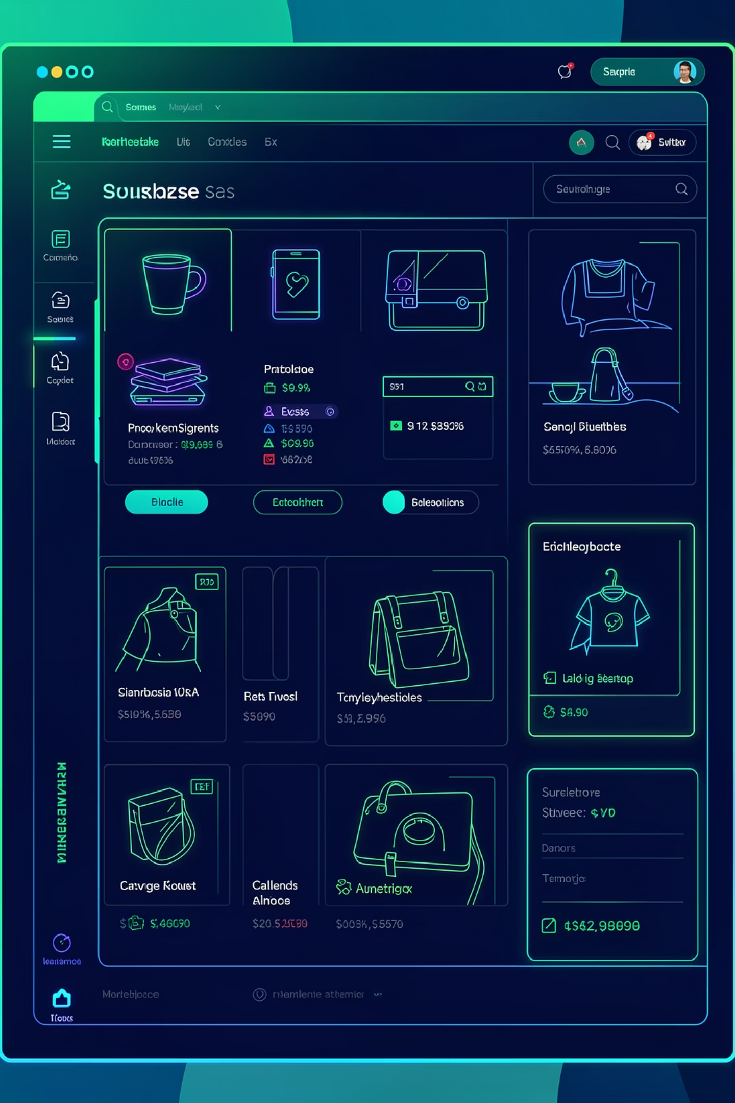
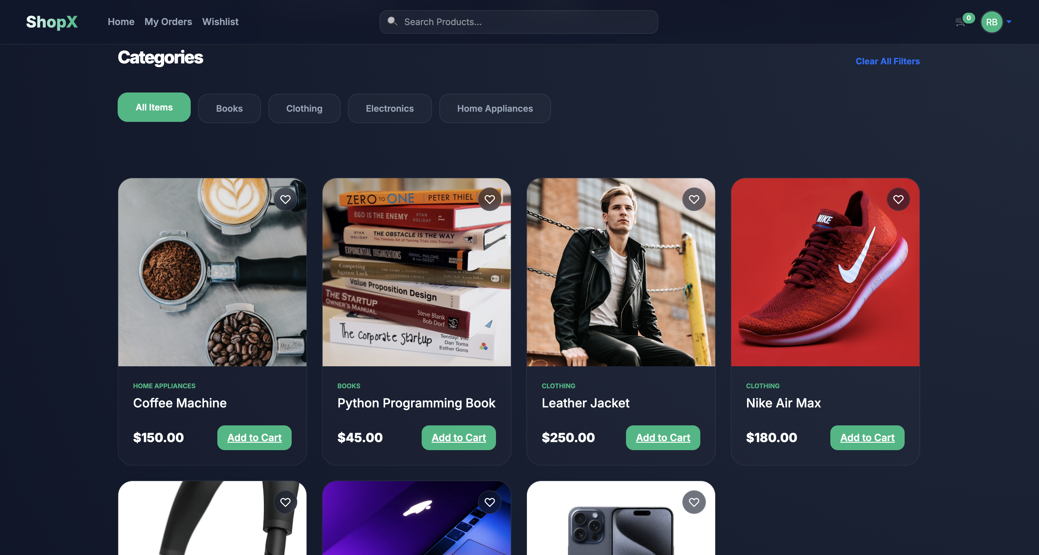

Commercial Store
Premium Multi-Vendor Marketplace built with Django
Team
Stack
Final Year Project Group
Django · Python · HTML · CSS · JS · SQLite
College
Computer Science Department

Slide 2
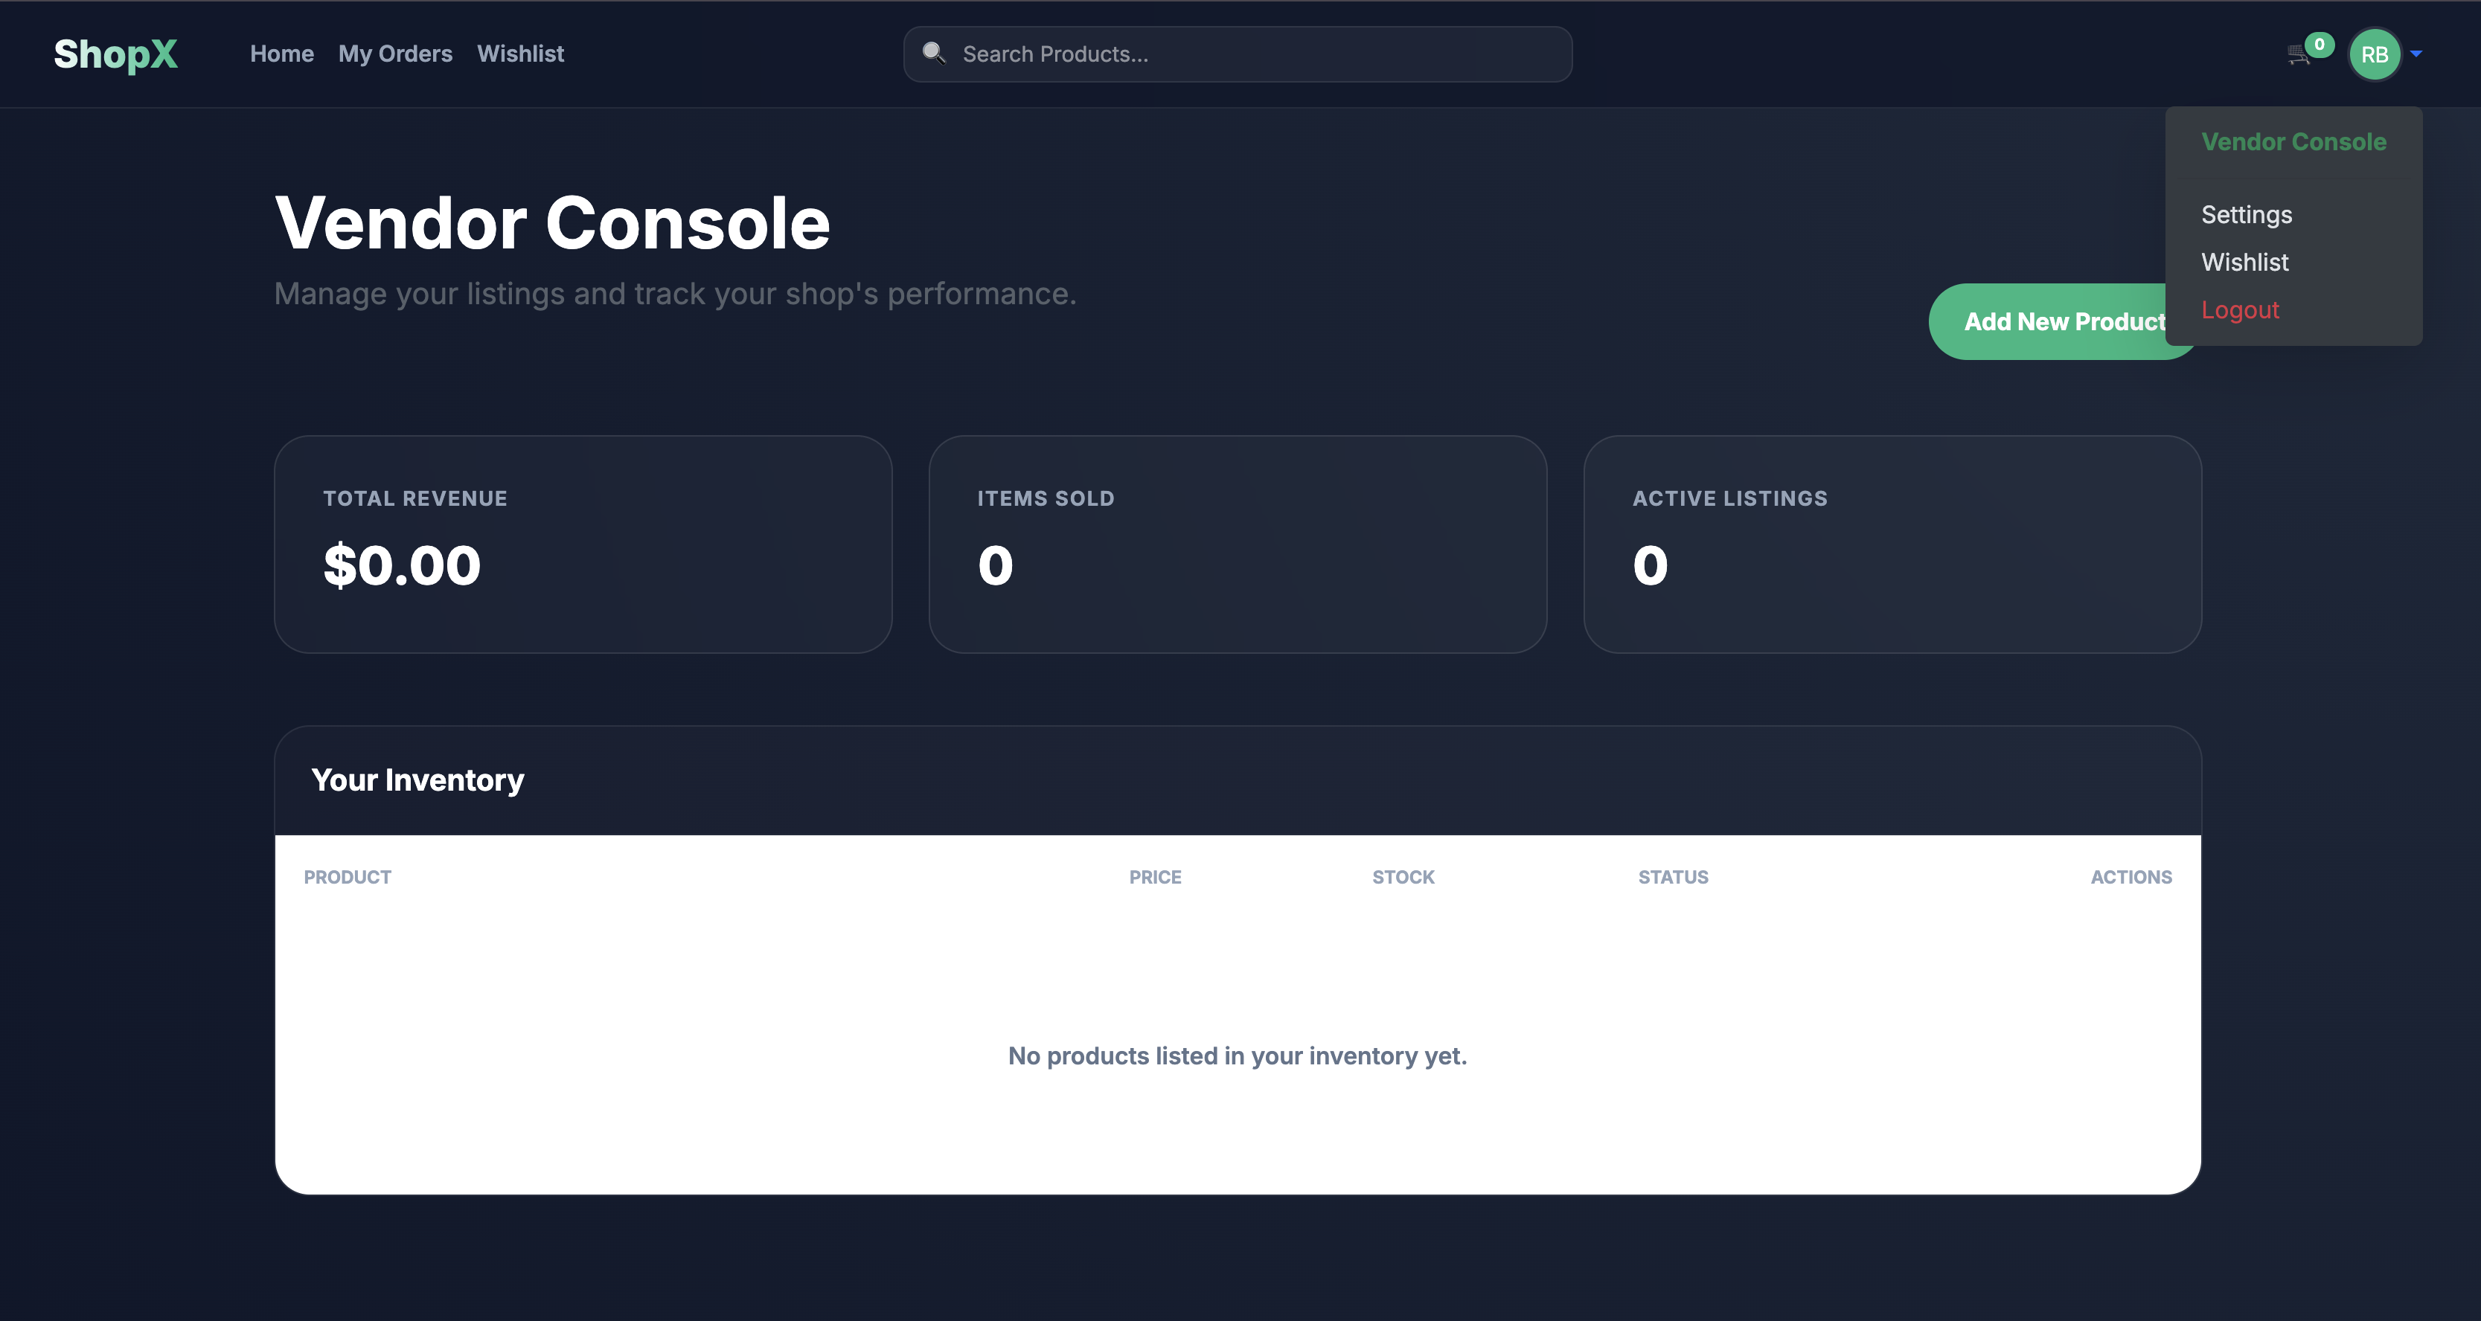

Problem Statement
Lack of Multi-Vendor Flexibility
Traditional e-commerce platforms are built for single sellers, making it difficult to onboard and manage multiple vendors under one roof.
Security & Scalability Gaps
Existing solutions often lack robust role-based access control, leaving systems vulnerable and unable to scale with growing vendor ecosystems.

Slide 3




Project Objectives
Secure Marketplace
Role-Based Access
Build a multi-vendor platform with OTP authentication and safe transactions.
Distinct permissions for Admin, Vendor, and Customer roles.
Smooth Shopping
Stock Consistency
Seamless cart, checkout, and order tracking experience.
Reliable inventory management and real-time order tracking.

Slide 4

System Architecture
Users app
Manages user accounts
Django MVT Structure
The project is modularised into four dedicated Django apps, each handling a distinct domain of the system.
MySql database
Django MVT Architecture
Products app
Central relational storage
Handles product catalog
All apps share a unified Mysql database with relational models for users, products, orders, and reviews.
Admin app
Orders app
Administration and management
Processes customer orders
Users
Products
Orders
Admin

Slide 5
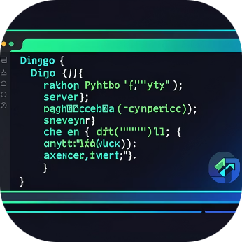
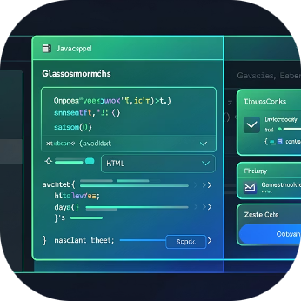
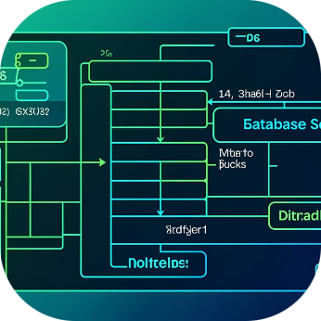
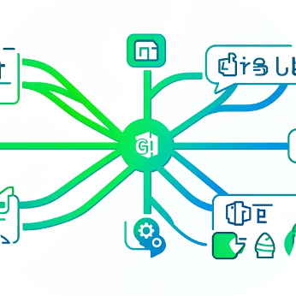
Technology Stack
Backend
Frontend
Database
Version Control
Django (Python) — robust MVT framework powering all business logic.
HTML, CSS (Dark UI with Glassmorphism), JavaScript for interactivity.
MySQL — lightweight, file-based relational database.
Git & GitHub — feature branch workflow with pull requests.

Slide 6






Key Features
Role-Based Access
Admin · Vendor · Customer
OTP Authentication
Secure login verification
Multi-Vendor Listings
Each vendor manages their own catalogue
Dashboards
Custom Admin & Vendor dashboards
Cart & Orders
Checkout, history & cancellation
Wishlist & Reviews
Save items & leave ratings

Slide 7
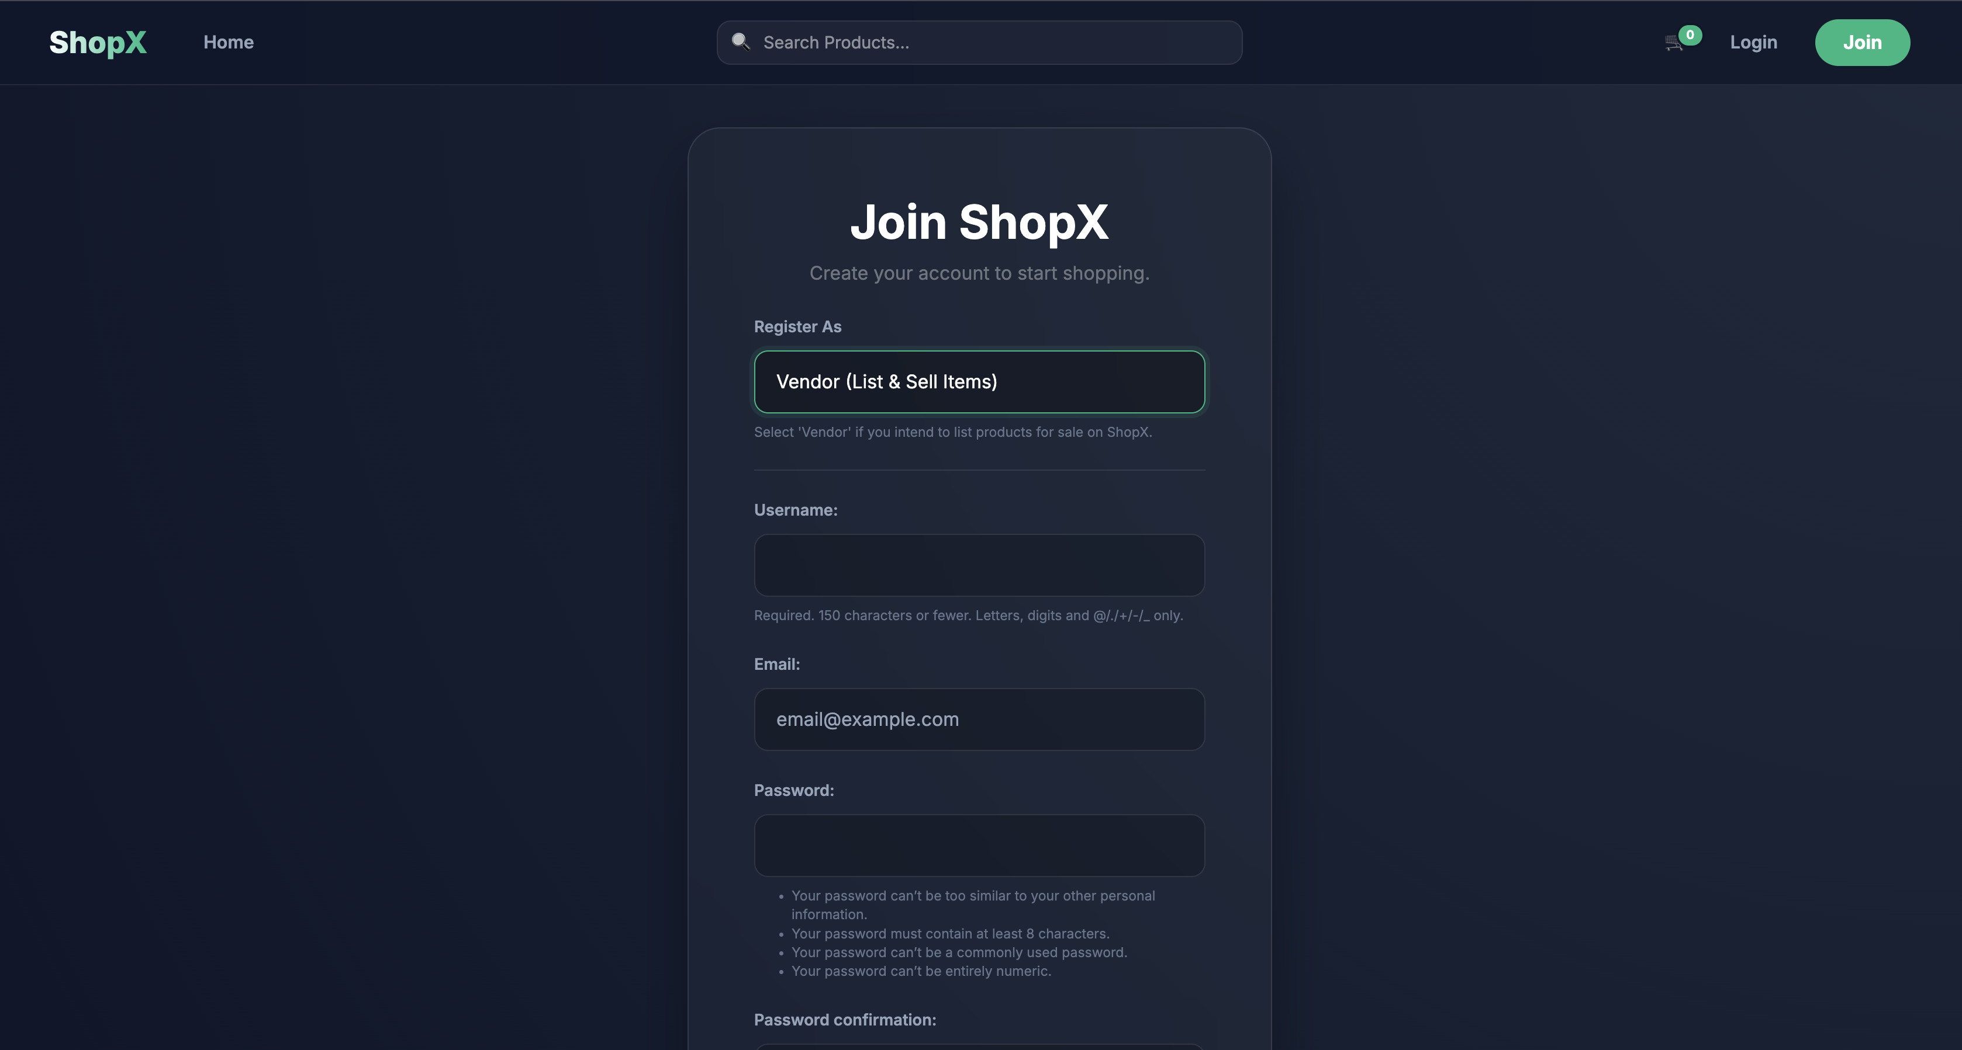
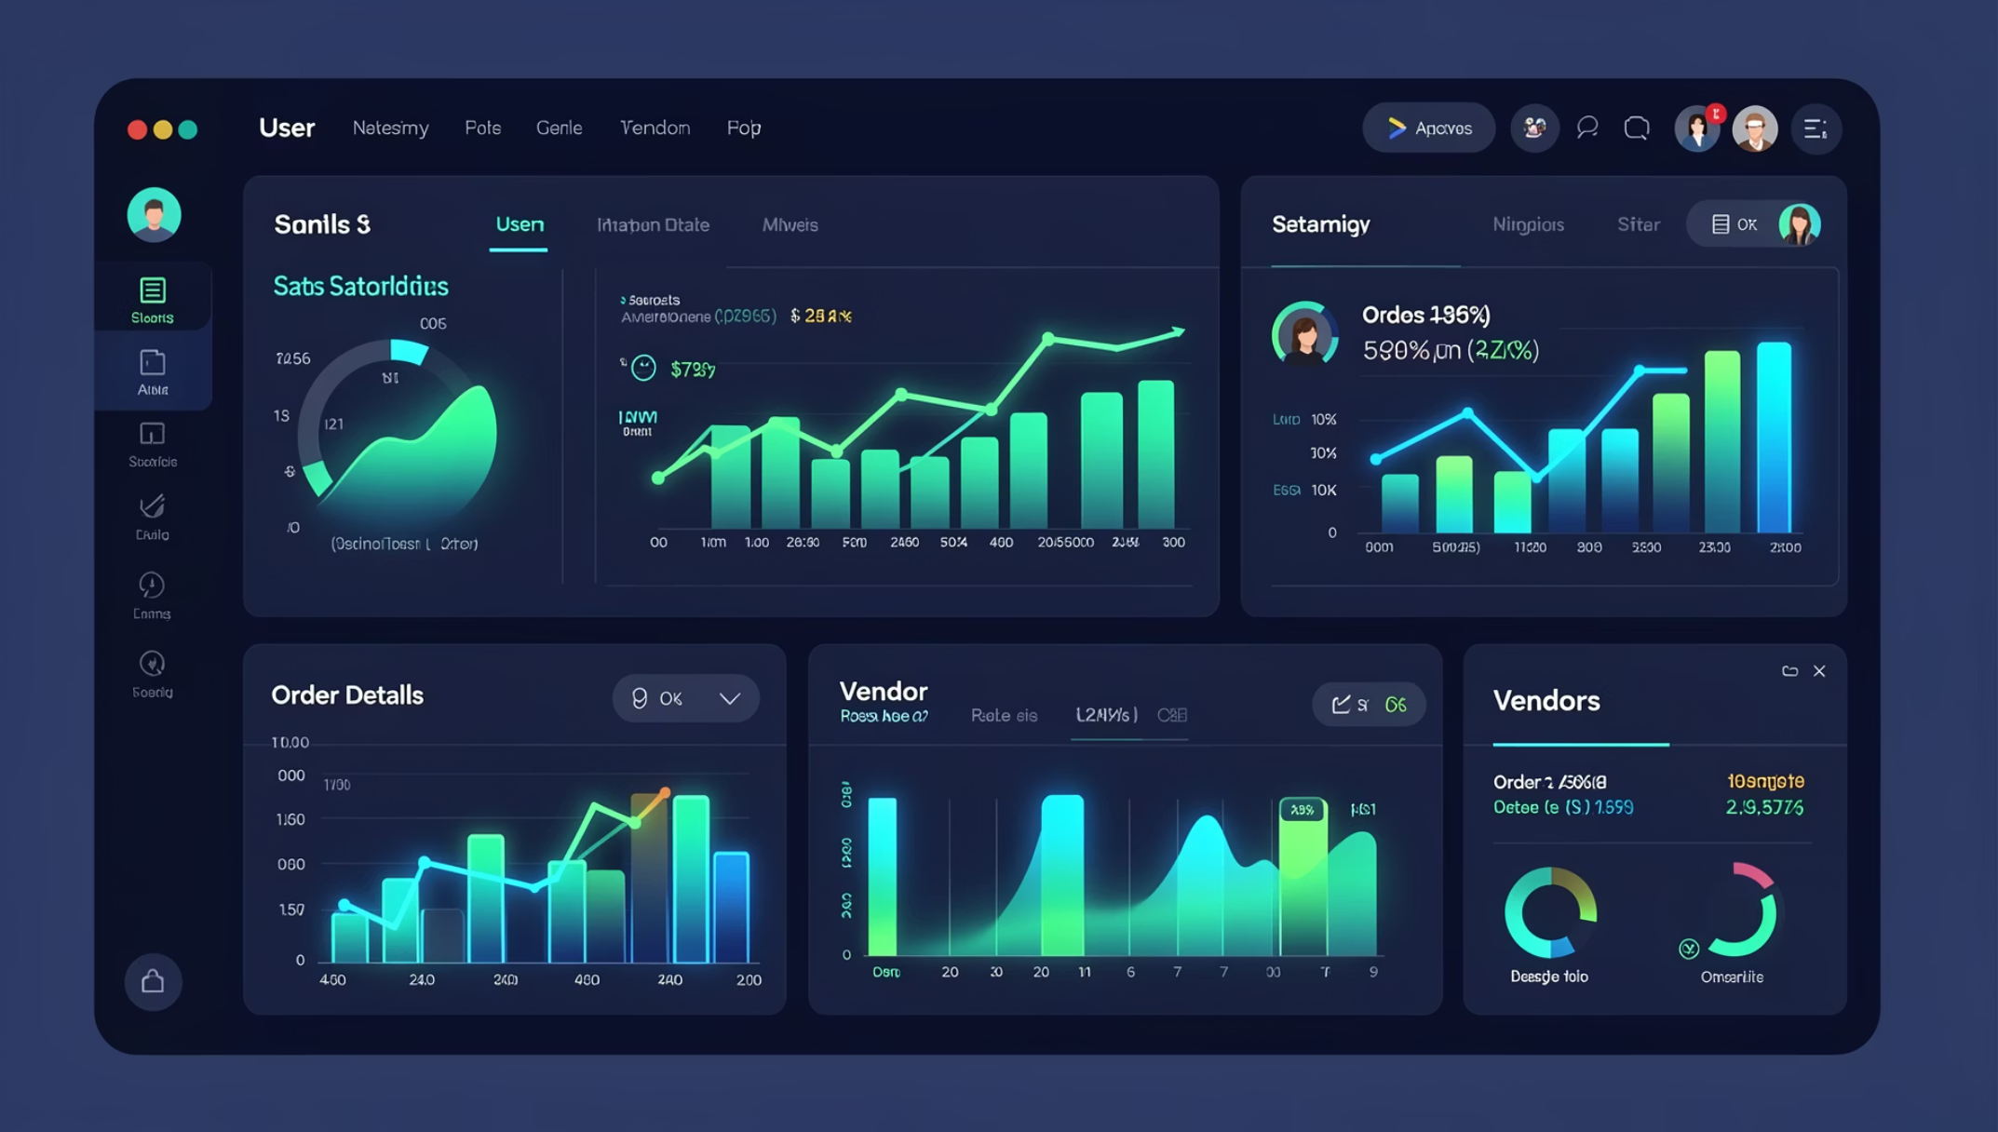
ADMIN MODULE
Custom Dashboard
A fully controlled vendor dashboard — vendor can add products, edit products, delete products.
👥 Total Users & Vendors
📦 All Orders Overview
⏳ Pending vs Completed

Slide 8
VENDOR & CUSTOMER MODULES
Vendor & Customer Experiences
Vendor
Customer
Add, edit & delete products
Revenue tracking dashboard
Monitor sales performance
Browse & search products
Add to cart & place orders
Track orders & view history
Leave reviews & ratings

Slide 9
Database Design & Security
Data Models
Security Features
User & Profile
Product & Category
🔐 OTP Verification
🔑 Login Auth
Authentication, roles, and profile data
Vendor-linked listings with stock tracking
Order & OrderItem
Review
🛡️ Staff-Restricted Panel
⚙️ Transaction-Safe Orders
Transaction-safe order placement
Customer ratings linked to products

Slide 10
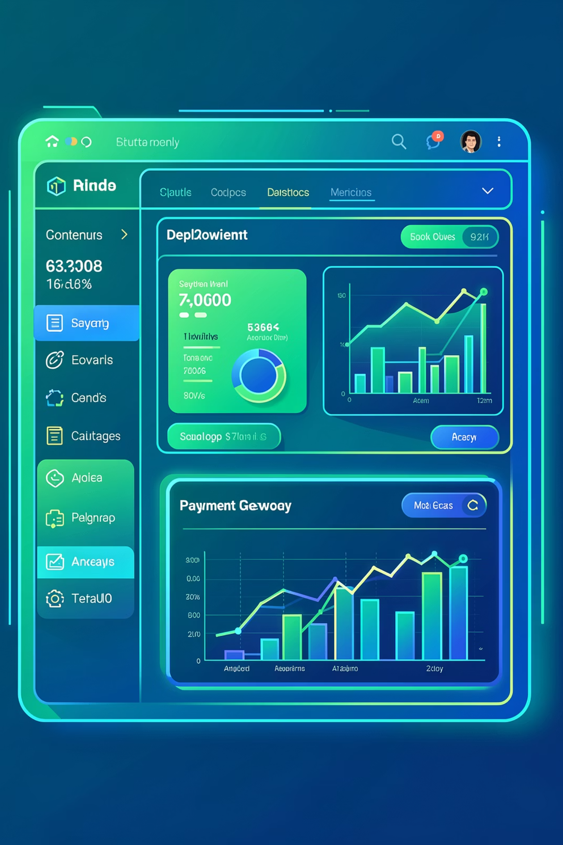

Challenges, Future & Conclusion
Challenges Faced
Future Enhancements
Stock consistency during checkout
Role-based access control complexity
Multi-vendor logic management
Merge conflicts in team development
Stripe / PayPal payment gateway
Analytics dashboard with charts
Real-time order tracking
Cloud deployment (AWS / Render)
Conclusion: Commercial Store delivers a scalable multi-vendor architecture, secure role-based implementation, and a production-ready structure — ready for real-world deployment.

